Slide 1

Purpose driven companies. Ethics in Management The 3.0 Corporation. An ethically driven company
Marcos Eguiguren
Barcelona, Academic Course 2019-20 (Q2)

Slide 2
Purpose driven companies. Ethics in Management

Slide 3
Ethics vs Business Ethics
Ethics
Choices that individuals make in their professional and personal life
Business Ethics
Shared set of attitude, morals, and rules of behavior that will guide decision making process associated with organizational activities
Trustworthiness
Respect
Responsibility

Slide 4

Business Ethics
Business ethics are meant to ensure a certain level of trust between consumers and corporations, guaranteeing the public fair and equal treatment
Ethical decision becomes source of distinctiveness and competitive advantage

Slide 5



Business Ethics
Implementing appropriate business policies and practices regarding arguably controversial subjects.
Topics include corporate governance, insider trading, bribery, discrimination, social responsibility, and fiduciary responsibilities.
The law usually sets the tone for business ethics, providing a basic guideline that businesses can choose to follow to gain public approval.

Slide 6
Code of ethics
Support of manager
Need explicit ethical objectives supported by policies and procedures
A code of ethics document outlines the mission and values of the business, of how professionals are supposed to approach problems
Develop training program
Monitor and measure success of program

Slide 7

Who establishes ethics in an organization?
Entrepreneurs
Entrepreneurs hold more ethical standards
Believe the firm is part of their property
Entrepreneurs are more interested in finding and developing a positive identity of him/herself.
Gain great satisfaction from running the business in an ethical way. More important than profit.
Managers
View the firm less part of their property
Legal, cultural, and educational factors influence ethical behavior
Employees usually follow leaders' decisions
Walk the talk

Slide 8







Create ethical environment
Trust and believe in employee; show acknowledgment
Effective communication between stakeholders (mission, vision,...)
Fairness; not judging but communicating
Encourage employees to voice their concerns
Action reinforces the code of ethics; inaction undermines it.
Involve employees in the process of creating the code
Corporate Social Responsibility

Slide 9



Corporate Social Responsibility
Describes a company’s ability to operate in a sustainable, ecologically friendly manner that benefits shareholders and employees
Organisation’s duty to its internal and external stakeholders' groups, acting as a good corporate citizen; going beyond legal requirements
Green initiatives are important

Slide 10
CSR: Fundamental Issues
Diversity issues: - Recruiting a diverse workforce - Every employee enjoys a respectful working environment
Decision making issues: - Protecting employee and customer rights - All operations are fair and just
Compliance and Governance issues: - Comply with environmental laws, state safety regulations
Harassment in the work place: - Maintaining professional workplace relationships between employees is a continuing challenge

Slide 11
CSR: Advantages & Disadvantages
Advantages
Competitive advantage
Better productivity through firm and sincere workers
Through increasing morale and trust business can increase their market share
Disadvantages
Reduce a company’s freedom to maximize its profit
Extra cost for solving certain ethical issues

Slide 12

Data Ethics: New solution to Big data ethical moral conduct
An example in technology: Data ethics
Data is the central entity to most of our products now-a-days.
Systemizing, defending and recommending concepts of right and wrong conduct in relation to Data, in particular personal data.
Notes:
* Since the dawn of the Internet the sheer quantity and quality of data has dramatically increased and is continuing to do so exponentially
* As we know in today's world, data is everything. A lot of startups are coming up based on data manipulation, providing intelligence software etc.
* In order to have a better regulation and good practices of using these data, we need some sort of Ethical code of conduct for it. Data Ethics branch if for that purpose.
* It defines, systematic, defending and recommending concepts of right and wrong conduct in relation to Data.

Slide 13
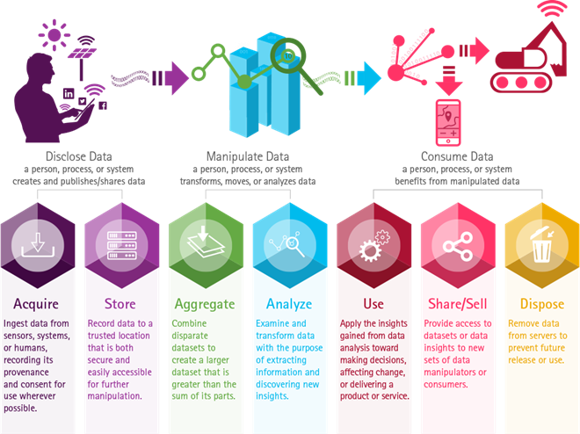
Data supply chain framework
https://www.accenture.com/us-en/blogs/blogs-new-data-ethics-guidelines-organizations-digital-trust
Notes:
* This is the data supply chain framework developed by Accenture company for organizations seeking to design, improve and enforce more ethical data practices.
*By using this framework and terminology, it sets the stage for analyzing ethical decision points and implementing ethical controls at different points of the supply chain.
* According to the framework there are three important steps which are further subdivided.

Slide 14
Ethical questions to ask during the data supply chain framework
Disclose data
How could the bias in the data affect the results?
Could the data be used for other purposes?
Manipulate data
Is the analysis of data introducing bias?
Are assumptions made on the model?
Consume data
Can the results be misinterpreted/abused?
Are the uncertainties, bias or assumptions properly represented?
Notes:
* These are some of the ethical questions that we should ask when we are dealing with data related entities, during the data supply chain framework.

Slide 15
Five principles of data ethics
Privacy: Safeguard customer data
Governance: Ensuring quality and accuracy of data
Data Ethics
Fairness: Using data in a way that respects person behind the data.
Shared benefit: Joint control of data and shared benefits.
Transparency: Open about data collection process.
Notes:
* To encounter the problems and ethical dilemmas, we have five principles of data ethics.
* They help us guide what is ethically wrong or right, when dealing with data.
* Privacy: That is, the data provided by the consumers is now owned by the company, who will use this data, but respect confidentiality.
* Governance: The focus here is on the internal processes that should be followed.
* Fairness: fairness means using data and algorithms in a way that respects the person behind the data. That means taking safety into consideration, and recognizing the impact the use of data can have on people’s lives. Example, ML on historical data does not discriminate against certain groups/communities.
* Shared benefit: this refers to the idea that data is owned by those that produce it and, as such, there should be joint control of the data, as well as shared benefits.
* Transparency: Transparency essentially refers to being open about the way data is collected and used, as well as avoiding unnecessary data collection

Slide 16
Technological innovation raises ethical issues
Innovations are reshaping the society, bringing fundamental changes
Companies can use unregulated technology to make profit
Rise of positive and negative social consequences

Slide 17
The 3.0 Corporation. An ethically driven company

Slide 18
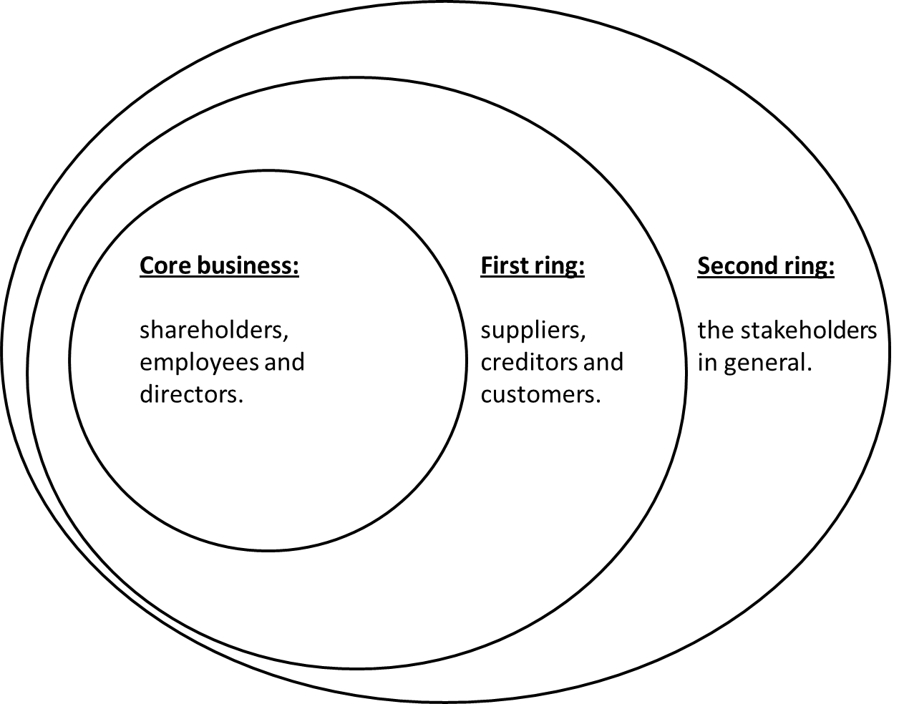

3.0 Corporation. The context: beyond the legal and regulatory framework
3.0 Corporation: A mission driven company afecting all rings:
Intentional Triple bottom Line focus at the core of the business model: People, Planet and shared Prosperity.
Stakeholder oriented vs shareholder only oriented.
Profit and Shareholder value as a consequence of doing the right things and doing them the right way

Slide 19
3.0 Corporation. A governance model for the good
The customer & suppliers Forum
The co-workersForum
Countervailing supervisory board or non executive directors. Mission driven
Independent Ethical Committees: Marketing & Sales, IT & Data Mgmt, Finances & Procurement,
Executive Mgment. MOPA & MOSA Philosophy

Slide 20
3.0 Corporation. Primary activities value chain (Mission Oriented Primary Activities: MOPA)
Procurement model based on an triple bottom line approach, suppliers selected based on :
3.0 for benefit Corporation due dilligence on their value chain
Quality and environmental respect
Price adjusted to net externalities produced. Transparency
Fair contracts, pricing and conditions with suppliers
Procurement
Inward logistics design based on the following criteria:
Zero km priority
Total time to premises
Environmental effects of transportation. Safety
Logistical cost adjusted to net externalities produced
Inward logistics
TBL Manufacturing and Service Development Criteria
3 Rs criteria all over the transformation process
Decent wages at manufacturing and services development
0 Waste poilicy
Final manufacturing costs adjusted to 3 Rs and 0 waste.
Manufacturing & Service development
Outward logistics design based on the following criteria:
Total time to client
Environmental effects of transportation. Safety
Logistical cost adjusted to net externalities produced
Outward logistics
A healthy and transparent marketing and sales activity
Radical transparency in Mktg and sales. Fair pricing
Mktg and Sales ethical committee
Goal setting based on real customer needs
Overconsumption self regulation
Marketing & Sales

Slide 21
3.0 Corporation. Supporting activities value chain. (Mission Oriented Supporting Activities: MOSA)
IT and Data Management
Self limitations imposed to IT and Data Management :
3.0 Quality procurement applied to IT suppliers
Mission driven data management
Radical compliance with data privacy regulations
Sharing data value with customers
Ethical Committe on IT and Data Management
Values based HR model:
Recruitment based on values
Training and HR Development based on values
Decent wage policy. Internal limitations higher vs lower and average salaries
Performance appraisal based on values in action
Bonus policy based on long term profitability, non monetary goals and values in action
Human Resource Management
Finance and
Accounting
Stakeholder oriented financial policy vs shareholder oriented financial policy:
Radical transparency and Maximum prudency in application of accounting principles
Internal limits to leverage and debt based on governance principles
Pay out policy limitations
Dual reporting from finance and accounting to CEO and to independent board members
Fair margin approach to pricing calculation
Legal, Compliance & Management Control
Radical Compliance and total transparency principles in management control
Periodical detailed reporting shared with all internal stakeholders
Management control based on 3.0 Corporation principles. Hard goals and soft goals to be monitored. Triple Bottom Line reporting.
Periodical reporting to external stakeholders.
Compliance with highest level international reporting standards

Slide 22
3.0 Corporation: The 12 Principles
1° It is a human community of interests which carries sustainability in its DNA and which applies it entirely in all its decision making process.
2 ° Its purpose is the satisfaction of the society´s rational need of products and services.
3 ° It aims to achieve sufficient profit to continue to contribute to social development.
4 ° It provides a fair compensation of capital, labor and knowledge (talent), as an integrated unit of thought and action.
5 ° It is deeply committed to the harmonious development of the planet and humanity.
6 ° It acts with full responsible freedom.
7 ° It contributes to the wealth and the common good and does not consume, in any manner, more resources than it produces.
8 ° It acts on the open market in an absolutely transparent, ethical and responsible manner.
9° It never focuses on speculative activities.
10 ° It shows a caring and responsible behaviour towards all stakeholders and for the rest of society and the environment.
11 ° It seeks a fair balance between growth and distribution of wealth.
12 ° It proactively wants to influence others and fosters sustainability in other actors in the systems with which it is related to.

Slide 23

The 3.0 Corporation, a summary
Stakeholder vs. shareholder driven
Conscious of its role as a major economic and social player
Knowledge, labour and capital community of interests
Looks for a social regeneration from an ethical view of the corporate role.
Looks for the triple bottom line: People, Planet and Prosperity
Its relationships with the rest of the society, specially with other companies aim to provoke change.

Slide 24

Key values in a 3.0 Corporation
Austerity
Proactivity
Transparency
Generosity
Responsibility
Honesty
What about CSR?

Slide 25

Uses recruitment, assessment and management by values
Towards the 3.0 Corporation
Actively promotes integrated communitis of clients
R&D and product development is linked to ethics and corporate values
Sales activity is structured as a long term relationship with the client
A zero cost based philosophy is used in cost management
Certains limits for corporate debt are set even since the incorporation act

Slide 26

Utopy as a source of Innovation and Progress
We achieved our objective because we didn’t know it was impossible
Federico Mayor Zaragoza

Slide 27
Thank you for your attention!
Marc.eguiguren@upc.edu

